Slide 1
ECII/ECSI 3206: Artificial Intelligence [and expert systems] Topic 8: Natural Language Processing
By: Edgar Otieno

Slide 2
Introduction to NLP
NLP-defines a method of communication with A.I system using natural language such as English . It may be in the form of speech , written text.
It involves making computers perform useful tasks with the natural language human use.
Text mining-deriving meaningful insight from normal language text [emails, sms, wordmaps]
NLP advanced over the years by combining the power of artificial intelligence (AI), computational linguistics, and computer science.

Slide 3
Why NLP
Tones of data are generated Within Digital systems : (https://www.internetlivestats.com/one-second/#email-band accessed on 17/5/2021)
3,036,757 Emails sent in 1 second
90,135 YouTube videos viewed in 1 second
9,520 Tweets sent in 1 second
1,079 Instagram photos uploaded in 1 second
5,744 Skype calls in 1 second
92,878 Google searches in 1 second
120,587GB of Internet traffic in 1 second

Slide 4
Cont..
NLP technology can be used to extracting information from unstructured text such as emails, newspaper articles, and user reviews into structured text. Structured text mostly takes the form of tables or values in a structured form.
Entity extraction refers to extracting entities from the text such as organizations, people, locations and so on. For example, the World Health Organization, IBM, Sara, John, Paris, US.
Relation extraction refers to identifying the relationship between entities, for example, “Bob Collymore was a CEO at Safaricom”; “Salesio is the Director of SCIT”.
Text summarization refers to the technique of shortening long pieces of text. Automatic text summarization is a common use case in machine learning and natural language processing.

Slide 5
Applications of NLP
Auto complete[for google searches,]
Optical character recognition (OCR) from documents (text that is scanned from actual documents)
Spam mail detection
Predictive typing[texting systems]
Spell checkers
Chatbots
Machine translation
Natural language assistants, such as Siri and Alexa
Sentiment Analysis[Analysis of social media content to help determine public opinion]

Slide 6
Selected Application Examples
1. Sentiment Analysis:
The process of identifying emotions or opinions that are expressed in user input.
Sentiment analysis answers various questions, such as how people feel about your product or whether your customers are satisfied with your customer service .
This analysis is used in marketing, retention plans, and emotional intelligence for chatbots

Slide 7
Cont…
2. Chatbots
Building solutions that can answer questions that are asked by humans in natural language. A question and answering system can be used for the following tasks:
Retrieving answers from forums.
Building a Frequently Asked Questions (FAQs) system.
Training chatbots

Slide 8


Slide 9
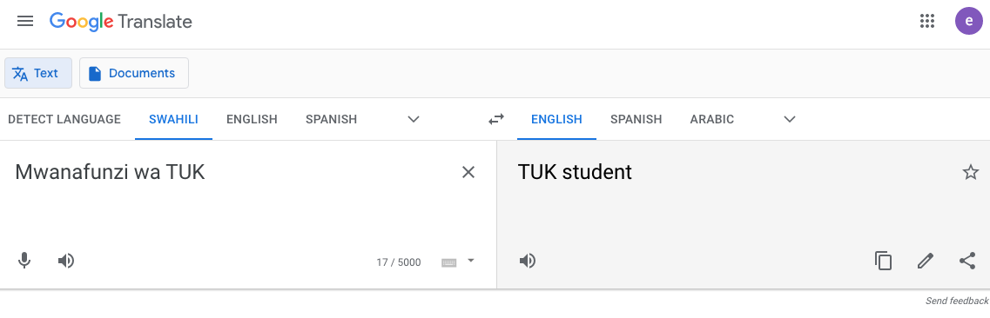
Machine translation

Slide 10
NLP Terminology
Morphology-It is a study of construction of words
Semantics-It is concerned with the meaning of words and how to combine words into meaningful phrases and sentences.
Phonology-It is study of organizing sound systematically.
Pragmatics-It deals with using and understanding sentences in different situations and how the interpretation of the sentence is affected.
Discourse-How current sentence can affect meaning of the next one.
Stop words-commonly used words in a language.
Document term matrix- A tool used to show the frequency of words in a particular document/set of documents.

Slide 11
Cont.…
Syntax-It refers to arranging words to make a sentence. It also involves determining the structural role of words in the sentence and in phrases
World of knowledge-It includes the general knowledge about the world.
Lexicon-Collection of phrases and words in a language.
Tokenization-Breaking down a sentence into chunks(tokens) for easier analysis
Stemming-normalize a word by removing prefix or suffix to have it in its root/base form
Lemmitization-Finding meaning of a word before stemming
Ambiguity-State of uncertainty in meaning

Slide 12
Cont..
Synonyms: are words that are written differently but are similar in meaning. For example: Clever and smart ,Begin and start, Beautiful and pretty
Antonyms: are words that have meanings that are opposite to each other. For example: Clever and stupid, Begin and end, Beautiful and ugly, Sad and happy
Polysemy: Words that have the same written form and a related meaning. For example: You must face your fear. Vs. Her face is beautiful.
Hyponymy: A word is a hyponym of another word if it represents a subclass of the other word. For example : Orange is a hyponym of fruit and Yellow is a hyponym of color
Text normalization: is the process of transforming text into a single form, which ensures consistency before operations are performed on it

Slide 13
Cont…
Here are some examples of normalization:
Examples:
Case folding: Child → child
Duplication removal: Hiiiiii → Hi
Acronyms processing: WHO → World Health Organization
Format normalization: Ksh100 → 100 Shillings
Value normalization: 2 July 1980 → DATE

Slide 14
Cont…
Homonyms: Words that have the same written form but have unrelated meanings. There are two types of homonyms:
Homographs: Words that have the same written form. For example:
This answer is right.
The building is on the right side of the river.
You have the right to remain silent.
Come here right now.
Homophones: Words that sound similar when spoken but have different meanings and spellings. For example:
“right” and “write”.

Slide 15
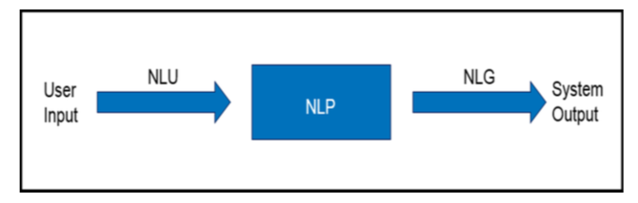
Components of NLP
Natural Language Understanding [NLU]
Natural Language Generation [NLG]

Slide 16
Components of NLP
1. Natural Language Understanding [NLU]- Involves mapping input in N.L into useful representation and analyzing different aspects of the language.
When doing this , some Ambiguities may arise as follows:
Lexical Ambiguity e.g consider the word Board , fly, jam, current ,Mine, orange , mto
Syntax level Ambiguity e.g He lifted the boy with the red rope
Referential Ambiguity/Anaphoric Ambiguity e.g she said I am tired

Slide 17
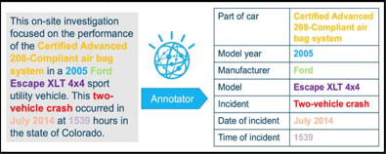
Cont…
NLU applications
Unstructured to structured
Question and answer system
Sentiment analysis

Slide 18
Cont…
2. Natural Language Generation [NLG]- Involves producing meaningful phrases and sentences in the form of natural language .It involves the following:
Text planning[ retreving content from a K.B]
Sentence planning[choosing the required words to make a sentence]
Text realization[mapping sentence plan into sentence structure]

Slide 19
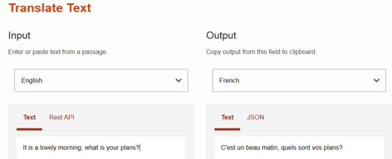
Cont…..
NLG applications
Machine translation
Text summarization
Weather forecasting system

Slide 20
Steps in NLP
1. Lexical Analysis − It involves identifying and analyzing the structure of words. Lexicon of a language means the collection of words and phrases in a language. Lexical analysis is dividing the whole chunk of txt into paragraphs, sentences, and words.
2. Syntactical Analysis − It involves analysis of words in the sentence for grammar and arranging words in a manner that shows the relationship among the words. The sentence such as “The school goes to boy” is rejected by English syntactic analyzer.

Slide 21
3. Semantic Analysis − It draws the exact meaning or the dictionary meaning from the text. The text is checked for meaningfulness. It is done by mapping syntactic structures and objects in the task domain. The semantic analyzer disregards sentence such as “hot ice-cream”.
4. Discourse Integration − The meaning of any sentence depends upon the meaning of the sentence just before it. In addition, it also brings about the meaning of immediately succeeding sentence.

Slide 22
5. Pragmatic Analysis − During this, what was said is re-interpreted on what it actually meant[ interpretation of actual meaning]. It involves deriving those aspects of language which require real world knowledge.

Slide 23
NLP pipeline
A pipeline is a way to design a program in which the output of one module feeds into the input of the next module.
Using the NLP pipeline divides the tasks of NLU, which makes NLU less complicated.

Slide 24
Example ..
We can use NLP pipeline to understand the following sentence: “Yes, I received your invitation, and I will happily attend your party.”
[This statement is understandable by a human but not a computer. We use the pipeline to walk though each stage to analyze the statement]
1. Sentence segmentation:[Detect sentence boundaries i.e. where sentence starts and Ends.]
There are two sentences in the example that are separated by the conjunction “and”:
“Yes, I received your invitation, and I will happily attend your party.”
Apply this process to the example:
“Yes, I received your invitation.”
“I will happily attend your party.”

Slide 25
2.Tokenization:[Breaks a sentence into tokens]
Tokenization uses delimiters, for example, a space ” “.Apply tokenization to the example:
First sentence: “Yes””,” “I” “received” “your” “invitation”
Second sentence: “I” “will” “happily” “attend” “your” “party”

Slide 26
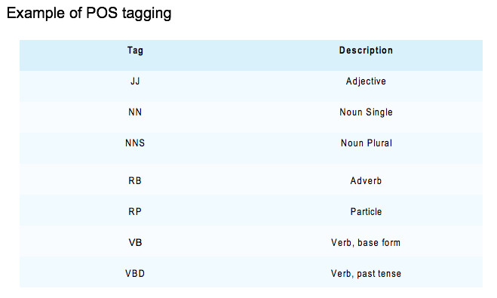
3.Parts of speech (POS) tagging:[The process of tagging each token with grammatical representation, such as noun, verb, or adjective).]
POS helps the computer to
understand language and
grammar and derive meaning from the input sentence.

Slide 27
Apply POS tags to both sentences.
First sentence: “yes/UH” “,/,” ”I/PRP” “got/VBD” “your/PRP$” “invitation/NN” “,/,”
Second sentence: “I/PRP” “will/MD” “happily/RB” “attend/VB” “your/PRP$” “party/NN”

Slide 28
Tools used in NLP
NLTK-Natural Language Tool Kit :A Python library that provides modules for processing text, classifying, tokenizing, stemming, tagging, parsing, and more.
Stanford Core NLP:A suite of NLP tools that provide part-of-speech tagging, a named entity recognizer, a co-reference resolution system, sentiment analysis, and more.
WordNet :One of the most popular lexical databases for the English language. Supported by various API and programming languages
Apache Open NLP : Provides tokenizers, sentence segmentation, part-of-speech tagging, named entity extraction, chunking, parsing, co-reference resolution, and more.

Slide 29
Services used in NLP
Instead of using low-level libraries, you can use many cloud services that accomplish high-level NLP tasks, for example, IBM Cloud, Microsoft Cloud (Azure), and Google Cloud.
IBM offers its AI services through IBM Cloud. The NLP services that are provided include the following ones (among others):
Watson Natural Language Classifier for text classification
Watson Natural Language Understanding for entity identification and relation extraction

Slide 30
Challenges to NLP
There are always some challenges that need to be tackled for any case. In NLP, here are the most popular challenges:
Domains: Higher accuracy for specific domains compared to generic domains.
Language: English gets the most attention because it is an international language.
Medium: Processing speech is more difficult than processing text.

